Slide 1
Making use of this deck
The content captured in this deck is intended for the trainer only
Some of the slides in this deck may be proprietary and/or confidential to Microsoft – i.e., they are not intended to be shared with customers
Slides included here do not appear in the customer-facing deck – rather, they are provided to the trainer to assist them in preparing for the delivery of the training module by complementing the customer-facing deck
Refer to the notes below each slide to obtain the rationale for inclusion

Slide 2
Suggested workshop format
Half-day workshop ~4 hours
Presentation & discussion ~1 hour
Guided hands-on session ~3 hours
Note: The customer-centric deck has too many slides for a 1-hour session. Feel free to hide/unhide and/or skip slides based upon the participants’ interests, background, etc.

Slide 3
Additional slides

Slide 4
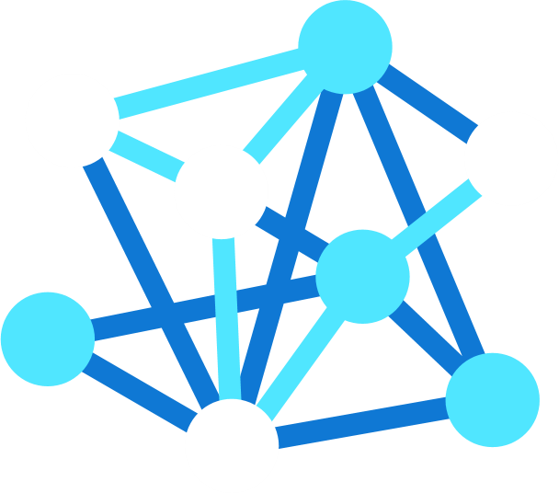
HPC on Azure
Transformative Services
Azure Machine Learning
Azure Data Lake
Azure ML Compute
Workload Orchestration
VM Scale Sets
Azure Batch
Azure CycleCloud
Fast, Secure Networking
ExpressRoute
InfiniBand
High Performing Storage
Azure HPC Cache
Azure NetApp Files
Clusterstore
Optimized Compute
H-Series
N-Series
Cray
Terawe Corporation Confidential. All Rights Reserved.
Notes:
Now, if you haven’t looked at Azure in a few months, you may be surprised to see what we have these days.
This is the high-level map of the class of services that we offer. We have well over 200 products and services.
You’ll notice we’ve extended to the edge. The ability to run application code in the cloud but also in that seamless, consistent way in the edge is informing our edge investments, whether it be Azure Stack, Azure Sphere, all the way to the Hololens and our Mixed Reality capabilities – these are powerful Edge devices that work in connection with the cloud.
You’ll see we have dev tools, devOps and great innovation, to the core infrastructure and PaaS services that we offer.
TRANSITION: Overall, this gives you the scope of what Azure as a platform and service can do for you.

Slide 5
A cloud built for HPC
Purpose-built HPC
Fast, Secure Networking
High Performing Storage
Workload Orchestration
Intelligence Services
A full range of CPU and GPU capabilities that help applications scale to 80K+ cores​
Fast InfiniBand inter-connects as well as edge-to-cloud connectivity​
A range of storage capabilities to support simple-to-complex storage needs​
End–to–end workflow agility using known, familiar tools & processes
AI, machine learning, and deep learning at supercomputer scale​
Notes:
High performance computing, or HPC, is a means of bringing more computing power to bear on these challenges.
Azure HPC has been designed as a market leading HPC solution combining the best of supercomputing and cloud approaches.
Critically, Azure HPC has been designed around you the inventor.
We support a smooth path from your baseline – so you can use the same trusted tools and processes to work with your overall workflow.
The engine underneath this is our purpose built HPC infrastructure, that delivers scale and speed to you. We don’t ask you to change your work to fit a vanilla cloud – the Azure HPC cloud is built to fit your workloads, including tightly coupled workloads, using the latest CPUs from Intel and AMD, plus GPUs, all backed by low latency high bandwidth Infiniband interconnect.
The Azure HPC offering spans compute, storage and networking capabilities, all optimized to deliver performance and elastic scalability to meet your simulation and modeling needs in an agile manner.
The Azure HPC also supports AI workloads, using GPU and CPU as appropriate, presenting the opportunity to add intelligence to the simulations workflows to help with parameter studies, results analysis, and more.
As an example of our leadership in this space, we are especially excited about the recent “AI supercomputer” announcement made by Microsoft’s CTO Kevin Scott.
This is one of the first steps of a close partnership between OpenAI and Microsoft working towards the next generation of very large AI models using the most powerful supercomputing capabilities.
Finally, the HPC community is recognizing our investments as a leader in this space. Last year, HPC Wire, one of the leading publications in the supercomputing space, awarded us the “Best” in category for both overall platform performance, as well as best individual use case.
The winning individual case study was engineers from processor company AMD executing the first physical verification of their largest 7nm chip design in just ten hours.

Slide 6

Solve any HPC, AI workload—at any scale
H/N
Cray in Azure
Managed custom bare-metal server
Large to extreme-scale HPC infrastructure
Azure network integration
L/M
D/E/F
Specialized VMs
H: High memory
HB: Memory bandwidth
HC: Compute-bound
NC: GP-GPU compute
ND: Deep learning
NV: Graphics applications
NP: Programmable FPGA
A/B
High memory VMs
L: High SSD & IOPS
M: Extreme memory
General-purpose VMs
D: Standard workloads
E: High memory
F: Compute-bound
A/B series VMs
Burstable virtual machines (VMs)
Small scale MPI
(Handful of cores)
Extreme scale MPI
(100k+ cores)

Slide 7

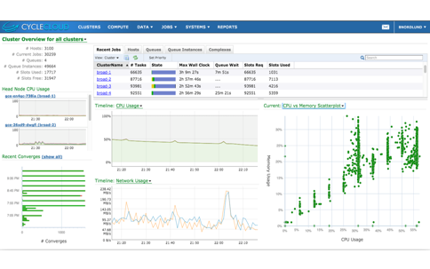
Azure CycleCloud
User empowerment
Able to cloud-enable existing workflows and schedulers
Enable instant access to resources
Provide auto-scaling, error handling
IT management
Link workflows for internal and external clouds
Use Active Directory for authentication and authorization
Provide secure and consistent access
Business management
Able to link usage to spend
Provide tools to manage and control costs
Notes:
Like Batch, Azure CycleCloud enables access to the Big Compute resources that Azure provides. Unlike Batch, which runs jobs in Azure, CycleCloud runs compute clusters. It is designed to allow line of business IT groups to provide easy access to cloud clusters for their users. Azure CycleCloud also features tools for managing the flow of data and compute jobs between internal and cloud clusters. Jobs can run where they’re best suited based on the specific requirements and the current resource utilization.

Slide 8

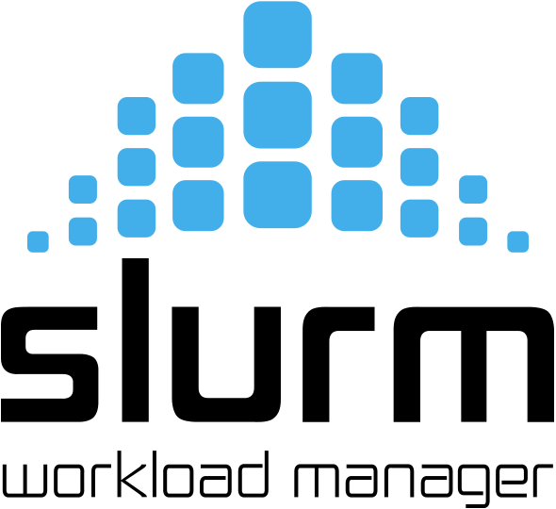






Support for traditional job schedulers
Symphony
Notes:
Azure Batch competitive position vs. these and other workload managers

Slide 9
Azure Storage
IaaS
PaaS
Virtual Machines
Storage
Networking
Frameworks
Web/Mobile
Microservices
Serverless
Disks
Files
Blobs
Tables
Data Lake
Persistent disks for Azure IaaS VMs
Premium Storage Disks option: SSD based, high IOPS, low latency
Fully managed file shares in the cloud
SMB and REST access
“Lift and shift” legacy apps
Highly scalable, REST based cloud object store
Block Blobs: Sequential file I/O
Cool Tier Available
Page Blobs: Random-write pattern data
Append Blobs
Client side HDFS
Massive auto-scaling NoSQL store
Dynamic scaling based on load
Scale to PBs of table data
Fast key/value lookups
Unlimited storage for HDFS based apps
Unlimited size accounts and objects
Built on Blob storage
Server side HDFS
Unified, distributed storage system
Durability, Encryption at Rest, Strongly Consistent Replication, Fault Tolerance, Auto Load-Balancing
Notes:
Cloud services and cloud usage are broadly defined as existing across infrastructure services or IaaS and higher layer platform services or PaaS. The Azure Storage services span both categories.
On the IaaS side we provide single instance storage for VMs in the form of our Disks service and SMB shared storage which we call Azure Files.
On the PaaS side we provide an unstructured object store called the Blob Storage service which offers Exabyte scale and the ability to store trillions of objects across different tiers within the cloud. Our current cloud object storage tiers are hot storage for higher performance and frequently accessed data and cool storage for active archives. In addition to unstructured data, we also have the NoSQL Tables service for semi-structured and structured data and the Queues service for reliable intra and inter-service communication.

